Slide 1
Unit 01 Part 2
Recurrences and Methods for solving the recurrences

Slide 2
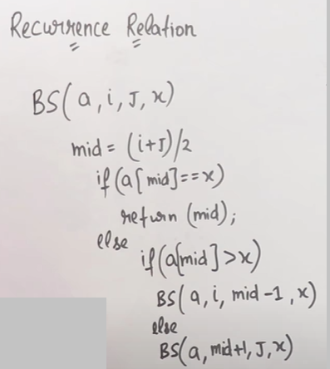

Slide 3
Recurrence Relations
A recurrence relation is an equation that describes a function in terms of itself by using smaller inputs
The expression:
⎧
⎪
c n = 1
T (n) = ⎨
⎛ ^{n} ⎞
⎪2T ⎜ ⎟ + c
n > 1
⎪⎩
⎝ ² ⎠
describes the running time for a function that contains recursion.
65

Slide 4
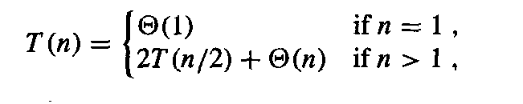
Recurrence Relations
Divide and conquer is a very common problem solving strategy in computer science
Recursion, where you solve a simpler version of the same problem, is a common application of divide and conquer
the recursion “bottoms out” in a base case
Merge sort divides a problem in “half” and solves each half separately
The recurrence relation is
Binary search divides a problem in half but only has to solve the problem for one of the two halves

Slide 5
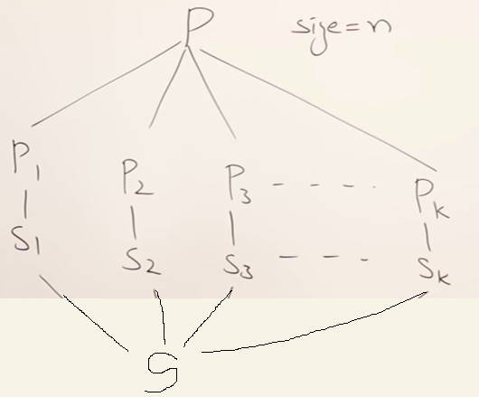
Divide and Conquer Strategy
You can use DAC strategy if you can divide the problem into subproblems of same type.
DAC is recursive.

Slide 6
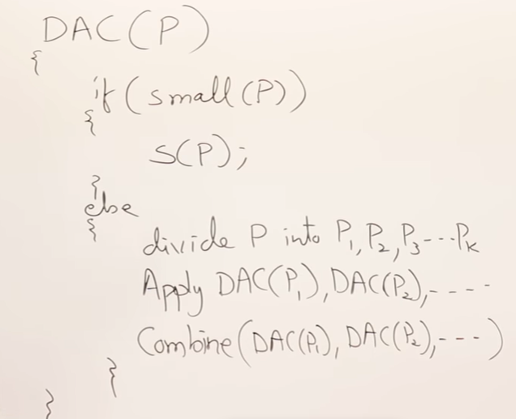
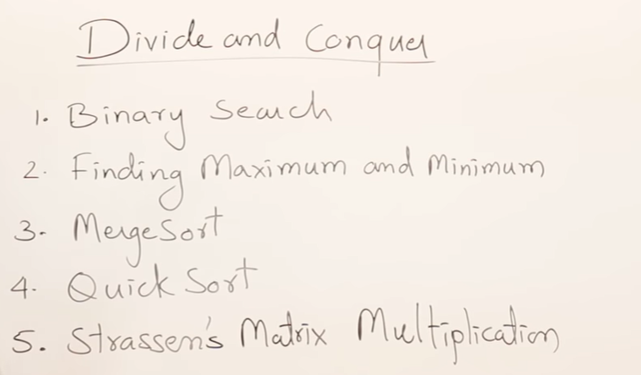
General method for DAC strategy
Problems for DAC strategy

Slide 7
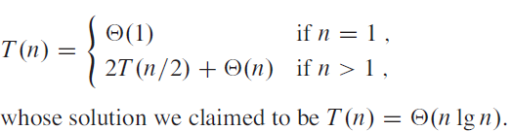
Recurrence Relation
A recurrence is an equation or inequality that describes a function in terms of its value on smaller inputs.
For example, worst-case running time T(n) of the MERGE-SORT procedure by the recurrence

Slide 8
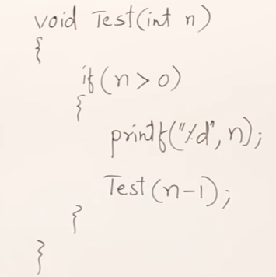
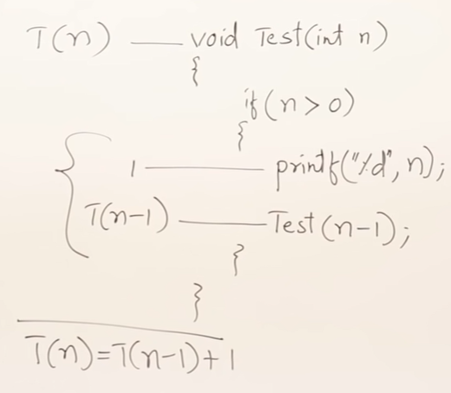
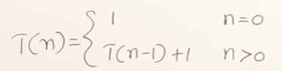
Recurrence Relation
A recurrence is an equation or inequality that describes a function in terms of its value on smaller inputs.
RR is

Slide 9
Recurrence Relation (T(n)= T(n-1) + 1)
RR is

Slide 10
Recurrence Relations
Definition
– Value of a function at a point is given in terms of its value at other points
Examples
– T(n) = T(n-1) + k
– T(n) = T(n-1) + n
– T(n) = T(n-1) + T(n-2)
– T(n) = T(n/2) + k
– T(n) = 2 × T(n/2) + k

Slide 11
Recurrence Relations
Base case
Value of function at some specified points
Also called boundary values / boundary conditions
Base case example
– T(1) = 0
– T(1) = 1
– T(2) = 1
– T(2) = k

Slide 12
Solving recurrences
The substitution method /induction method
The recurrence tree method (sum up complexity at each level, then sum all the levels)
The master method (prove a general theorem once then apply the theorem where appropriate; covers many common cases but not all cases)

Slide 13
The substitution method to solve RR
In the substitution method, we guess a bound and then use mathematical induction to prove our guess correct.
We can solve all recurrence relations using this method and this method always gives the correct solution.
However this method involves a large amount of calculations.

Slide 14
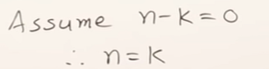
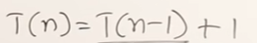
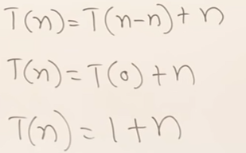
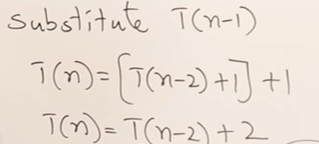
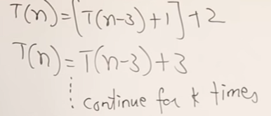
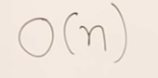
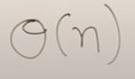
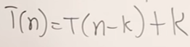
Solve Recurrence Relation (T(n)= T(n-1) + 1) using substitution method

Slide 15
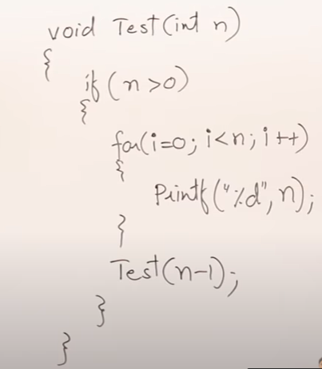
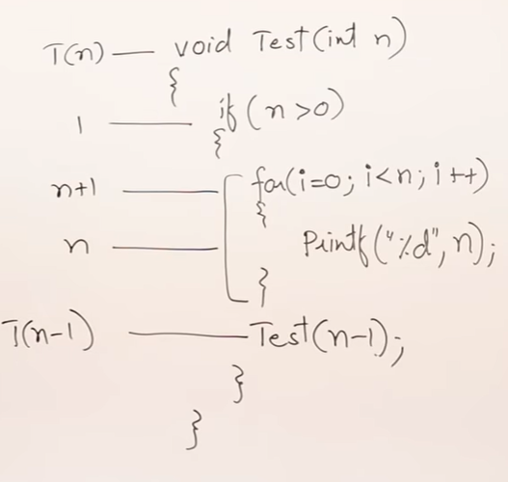
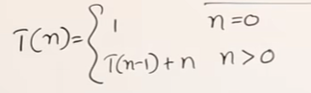
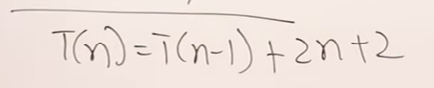
Recurrence Relation for decreasing function
(T(n)= T(n-1) + n)
RR is

Slide 16
The recursion tree method to solve RR
In this method, we draw a recurrence tree and calculate the time taken by every level of tree.
Finally, we sum up the time taken at all levels.
To draw the recurrence tree, we start from the given recurrence and keep drawing till we find a pattern among levels.
The pattern is typically a arithmetic or geometric series.

Slide 17
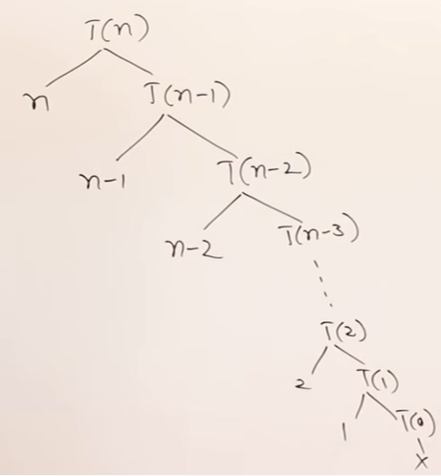
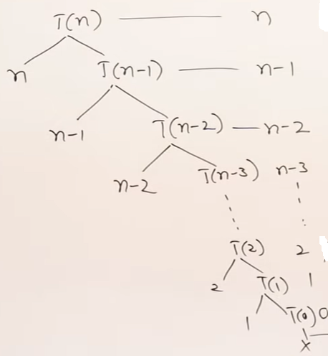
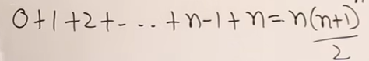
Solve Recurrence Relation (T(n)= T(n-1) + n): Recursion Tree Method
Calculate the time taken by every level of tree
sum the time taken at all levels
Draw Recursion Tree
T(n)= O(n²)
= θ(n²)

Slide 18
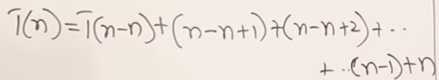
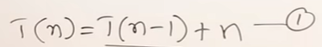
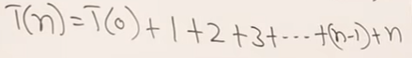
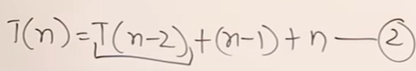
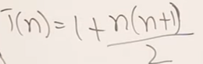
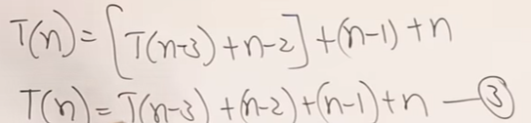
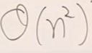
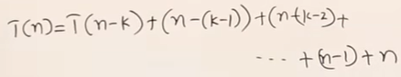
Solve Recurrence Relation (T(n)= T(n-1) + n): Substitution method
.
.
.
Continue this k times
---4
Now assume that we have reached T(0) i.e assume that n-k=0 i.e n=k
Substitute k=n in eq 4.

Slide 19
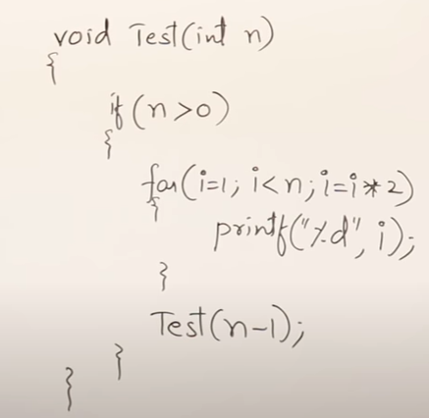
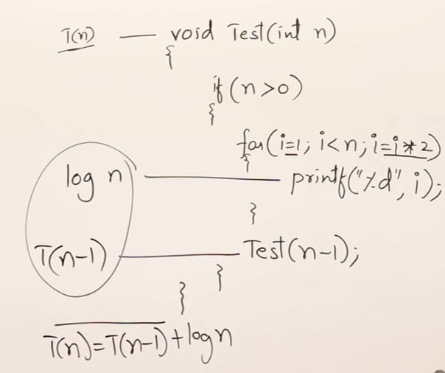
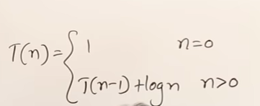
Recurrence Relation for decreasing function
(T(n)= T(n-1) + log n)
RR is

Slide 20
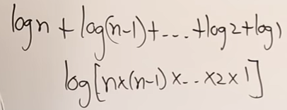
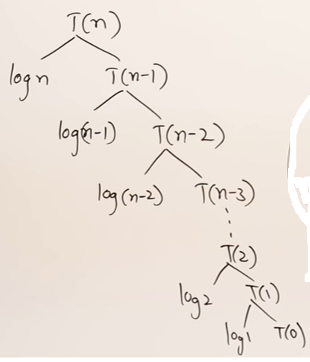
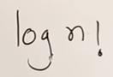
Solve Recurrence Relation (T(n)= T(n-1) + log n)
There is no tight bound for log n!. But there is UB for log n! and it is n^{n}
Hence T(n)= O(log n^{n})= O(nlog n)

Slide 21
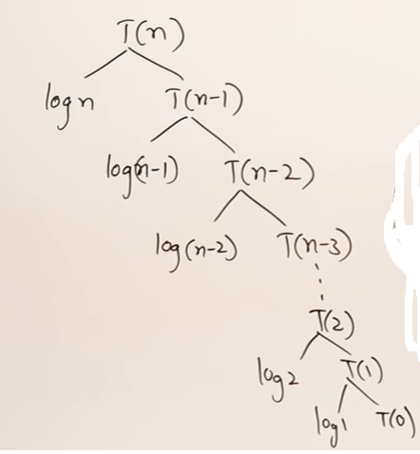
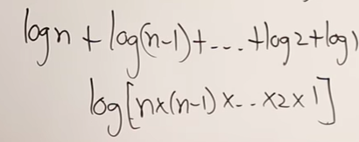
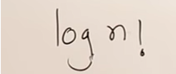
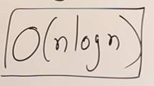
Solve RR using recursion tree method

Slide 22
Exercise: Solve RR using substitution method

Slide 23
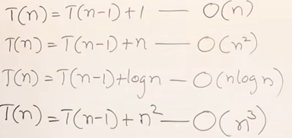
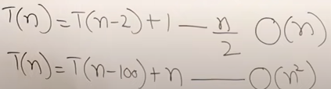
Observations
T(n)=2T(n-1)+1 What is TC?

Slide 24
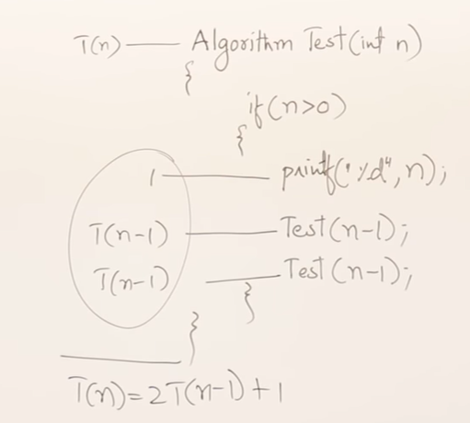
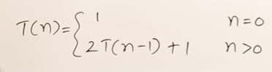
Recurrence Relation T(n)=2T(n-1)+1

Slide 25
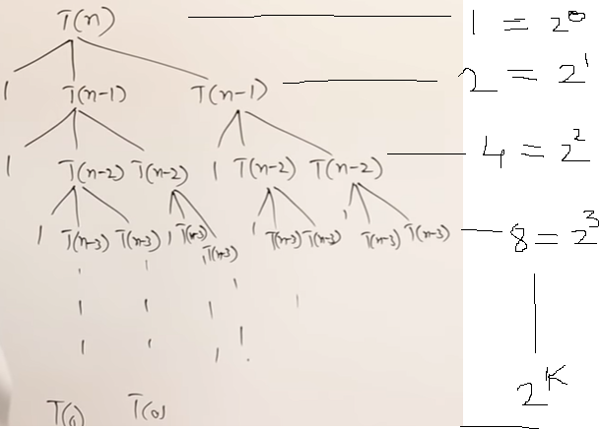
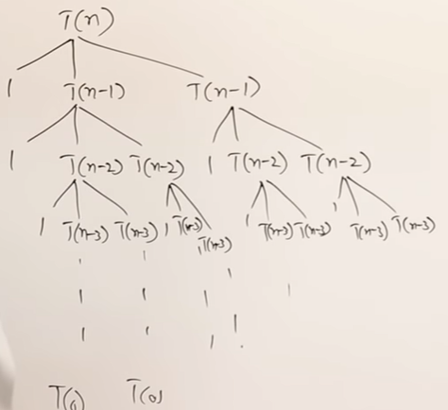
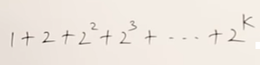
Solve Recurrence Relation T(n)=2 T(n-1)+1. Use Recursion Tree method

Slide 26
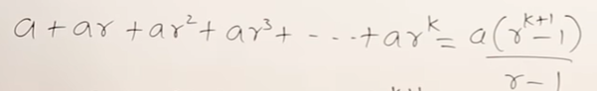


GP series
Assume n-k=0 .
Hence n=k.
T(n) = 2^{n+1} - 1 i.e O(2^{n}) or θ (2^{n})
Try to solve using substitution/induction method

Slide 27

Observations

Slide 28





Master’s Theorem

Slide 29



Recurrence Relation Dividing Function T(n)=T(n/2)+1
RR is:

Slide 30
Solve using substitution method/recursion tree method
Ans: O(log n)

Slide 31



Recurrence Relation [ T(n)= 2T(n/2) +n]
RR is:

Slide 32







Solving RR Dividing function[ T(n)=T(n/2)+ n]: Recursion Tree method
RR is:

Slide 33





Masters Theorem in Algorithms for Dividing Function
General form of RR for Master’s Theorem
Find following 2 value based on which there are 3 cases::

Slide 34









Example 1:
Example 2:
=

Slide 35






Example 1:
Example 2:
Example 3:
Example 4:
IMP: If and power of n i.e k are equal and p>-1, then TC =ʘ(f(n).logn)

Slide 36





Example :
=

Slide 37



Example :

Slide 38










Example1 :
Example2 :
Example3 :
Example4 :

Slide 39


Case 1 Examples

Slide 40


Case 2 Examples

Slide 41


Case 3 Examples

Slide 42





Root function (Recurrence Relation)
In the root recurrence relation, the smallest value should be >=2. Otherwise you may not be able to solve this RR.
TC=? Solve using substitution /recursion tree method
Solving using substitution method is:
RR is:

